Slide 1

DEPARTMENT OF INFORMATION TECHNOLOGY
Project name : Smart Water System
Team name : Proj_224784_Team_6
Team members :
Janish kumar U(113321205020)
Kotte Chandu(113321205026)
Kishore KV(113321205024)
Yuvaraj V(113321205060)

Slide 2
Smart Water System
Introduction
Smart Water System refers to the integration of technology and data-driven solutions in the management of water resources, distribution, and consumption.

Slide 3
What is a Smart Water System?
Definition: Smart Water Systems are advanced technologies that use sensors, data analytics, and automation to monitor, manage, and optimize water resources.
Key Components: Sensors, Data Analytics, Communication Networks, Control Systems.

Slide 4

Importance of Smart Water Systems
Water Scarcity: Global water scarcity is a growing concern.
Efficiency: Smart systems optimize water usage, reducing waste.
Sustainability: Enhanced environmental conservation.

Slide 5
Components of Smart Water Systems
Sensors: Collect data on water quality, usage, and infrastructure.
Data Analytics: Analyze data to identify patterns and anomalies.
Communication Networks: Transmit data to central control systems.
Control Systems: Implement automated actions for water management.

Slide 6
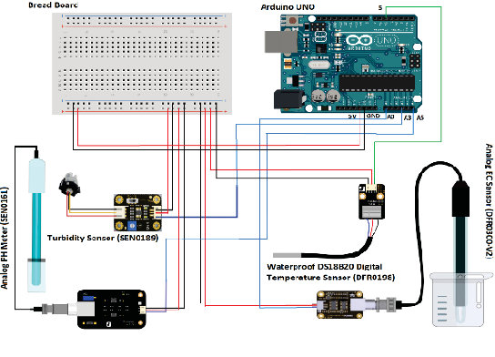
Smart Water System circuit diagram

Slide 7

Benefits of Smart Water Systems
Efficient Resource Management: Optimize water distribution.
Leak Detection: Quickly identify and fix leaks.
Real-time Monitoring: Instant response to changing conditions.
Predictive Maintenance: Prevent infrastructure failures.
Water Quality Control: Ensure safe and clean water.

Slide 8
Applications of Smart Water Systems
Water Distribution Management
Leak Detection and Prevention
Irrigation Optimization
Water Quality Monitoring
Flood and Drought Management

Slide 9
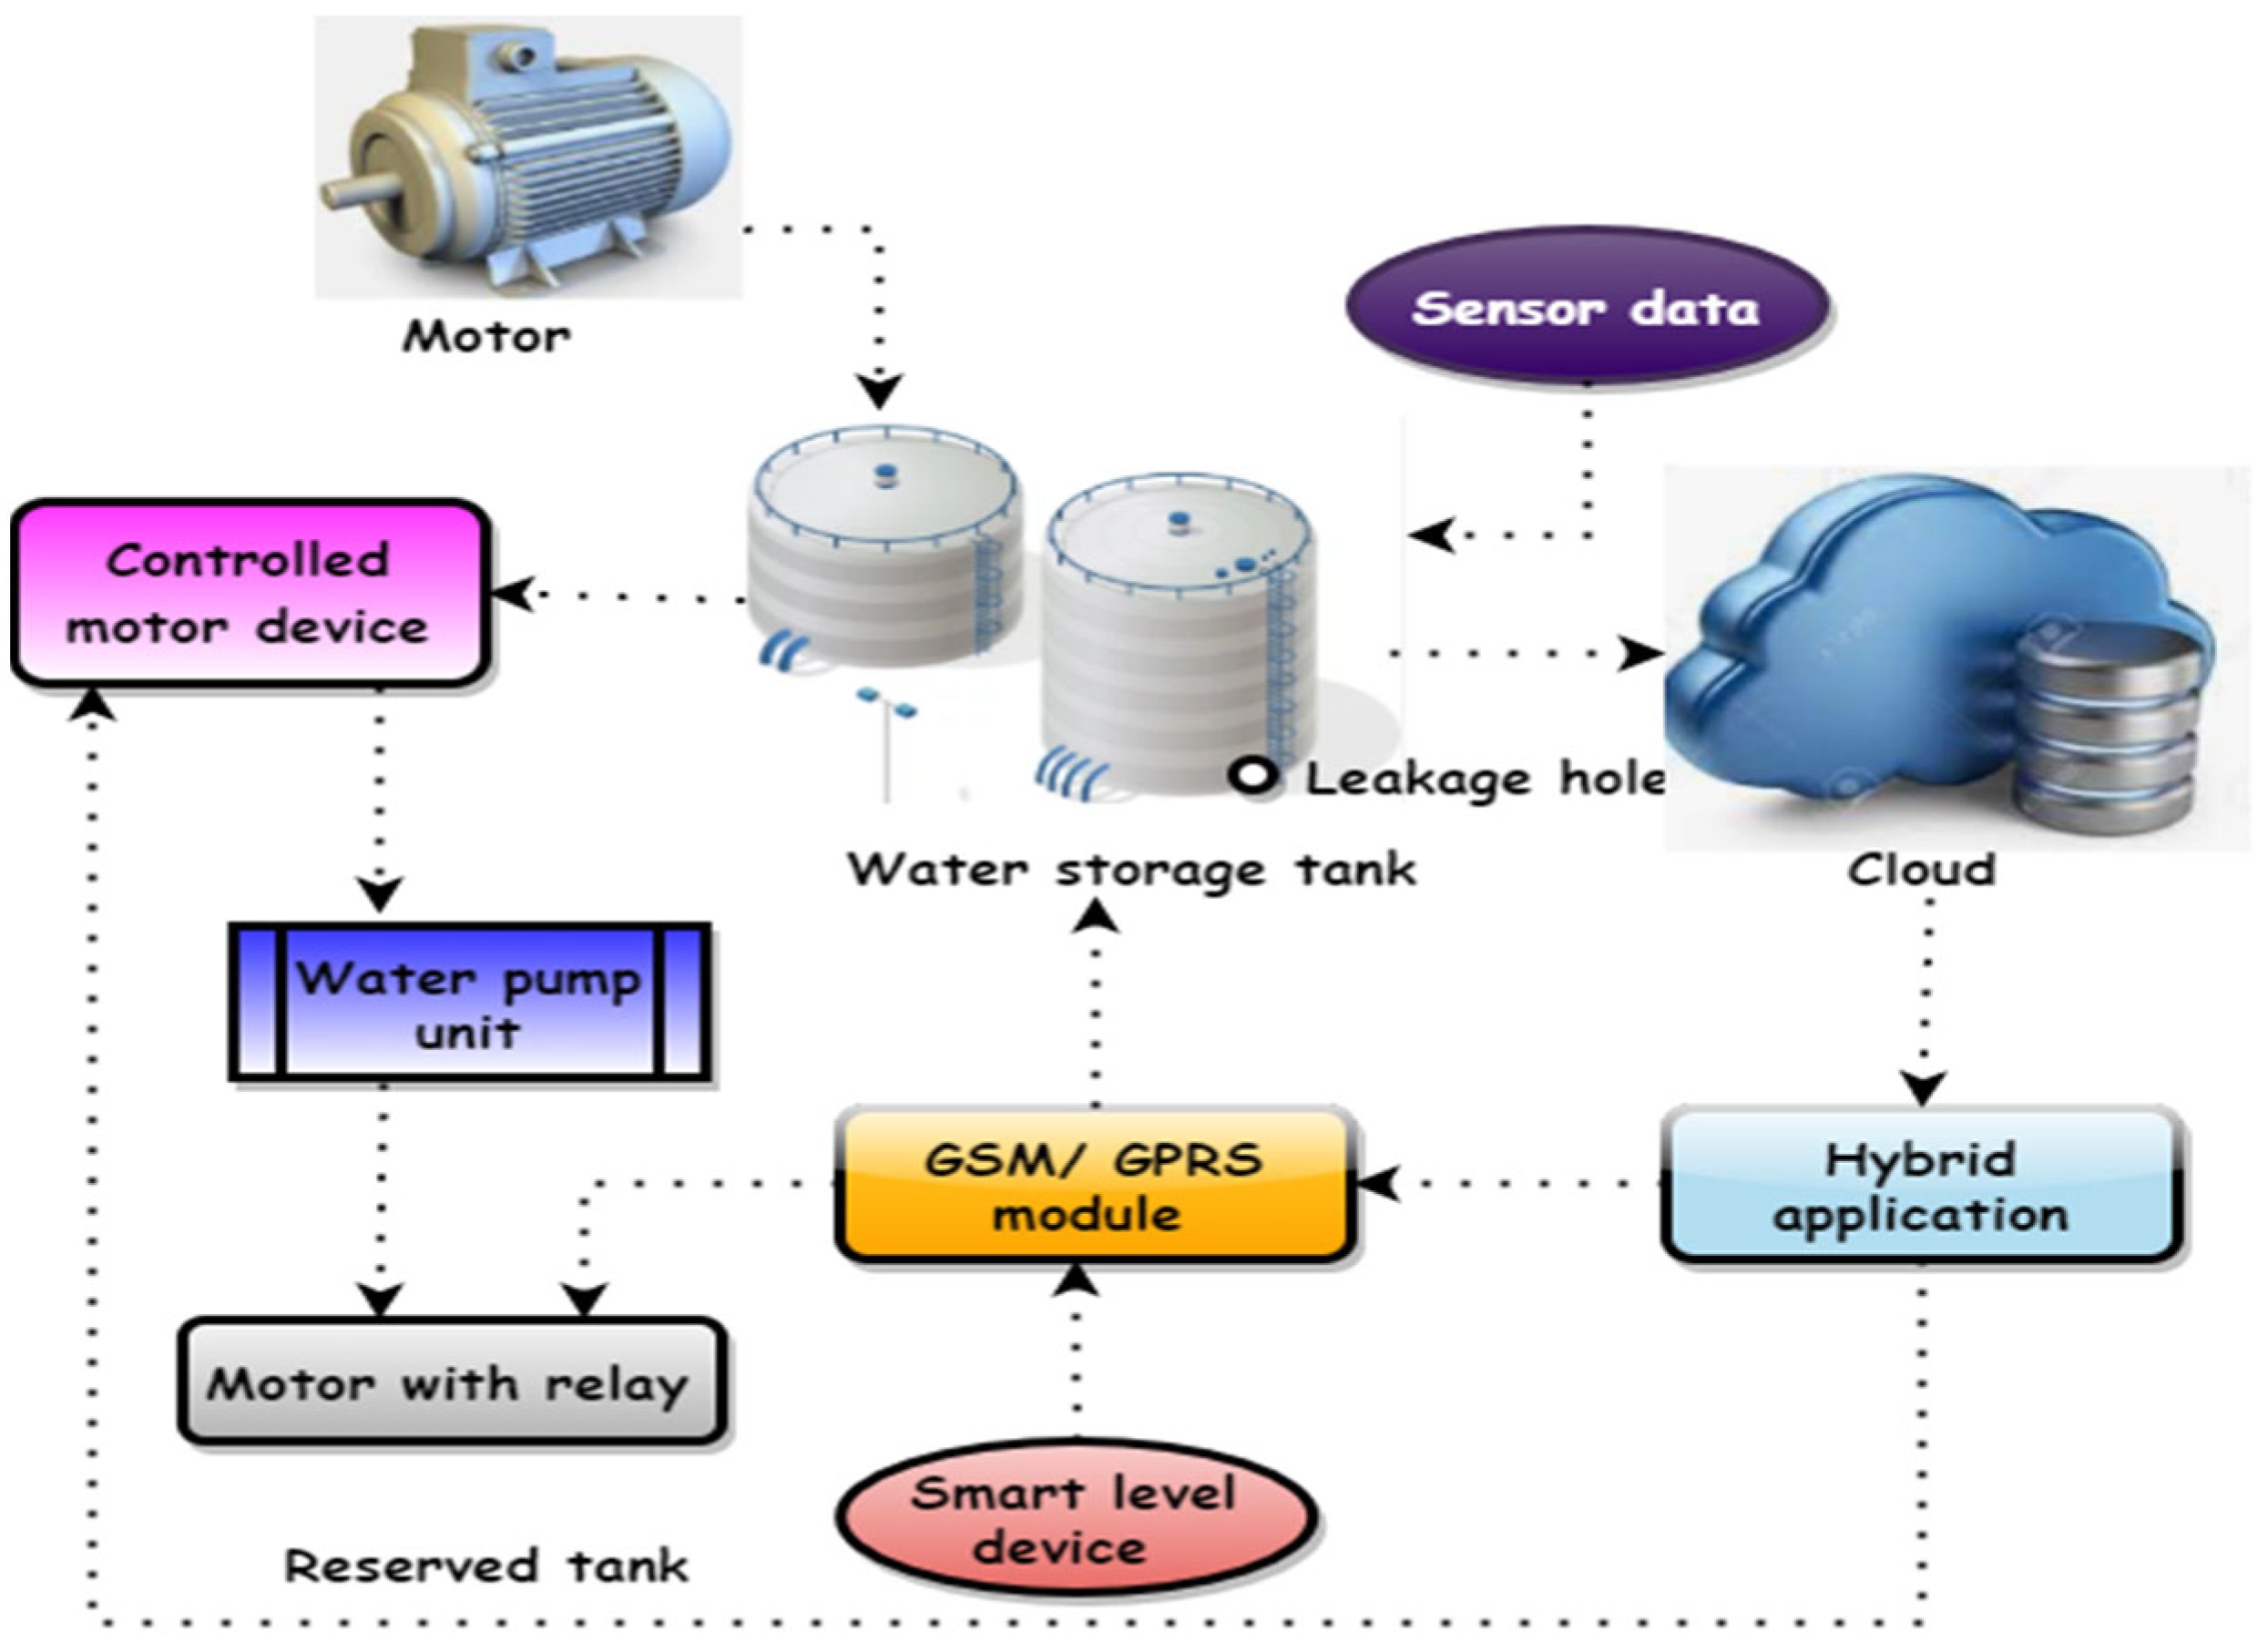
Smart Water System model

Slide 10
Case Study - Barcelona's Smart Water System
Example of a successful implementation.
Reduced water loss by 25%.
Improved water quality and service.

Slide 11
Future Trends and Challenges
Future Trends
High Initial Costs
Data Security and Privacy
Integration with Legacy Systems
Technical Expertise Required
Challenges
AI and Machine Learning Integration
Decentralized Water Management
Increased Adoption in Developing Nations

Slide 12
Conclusion
Smart Water Systems are crucial for sustainable water management.
They offer efficiency, conservation, and improved water quality.
Investment in these systems is an investment in our future.

